Slide 1
DNA and Heritable Traits
Lesson 7

Slide 2
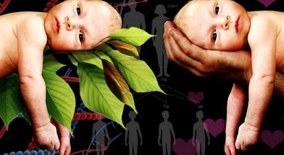
Nature vs. Nurture

Slide 3
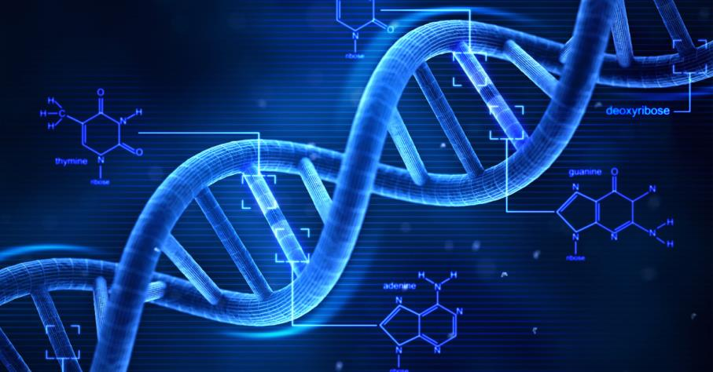
DNA

Slide 4
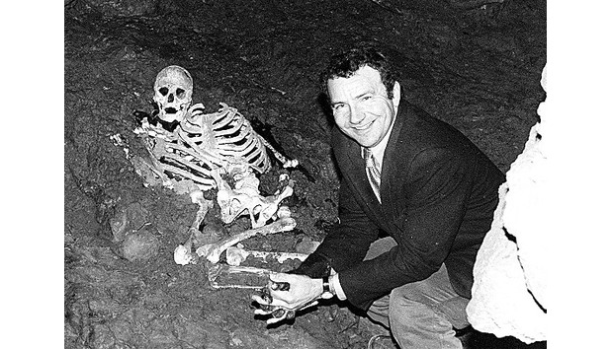
9000 yr old relative found…

Slide 5
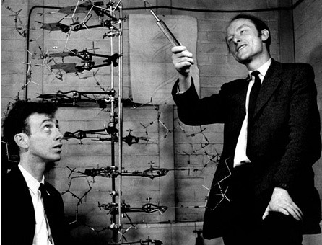
Founders…

Slide 6
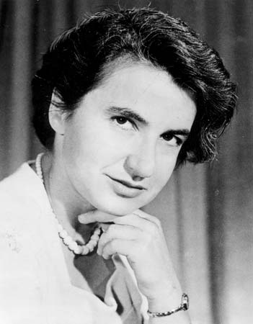
And… Rosalind Franklin

Slide 7
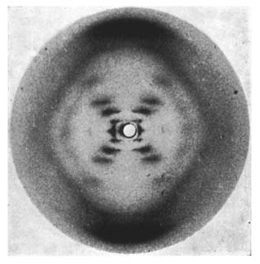
DNA?

Slide 8
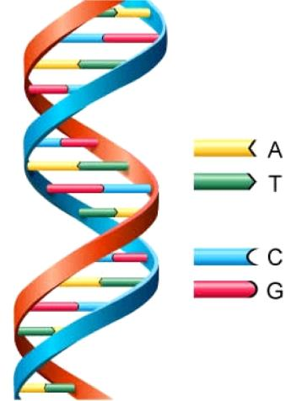
DNA Structure

Slide 9
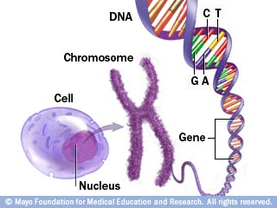
DNA Forms

Slide 10
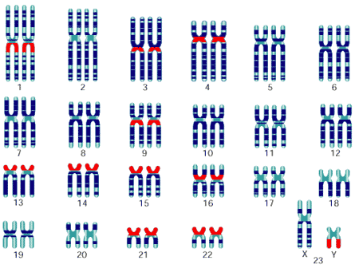
Chromosomes

Slide 11
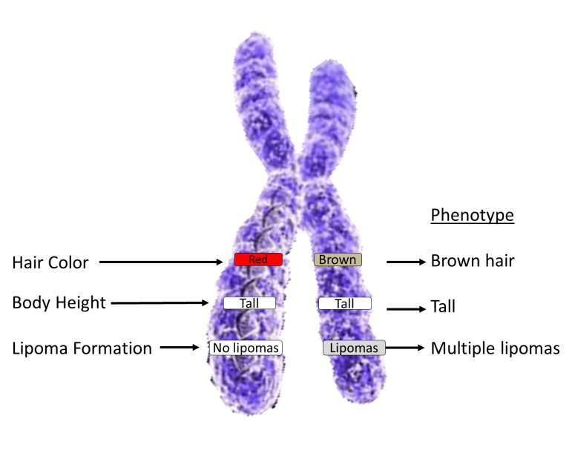
Alleles

Slide 12
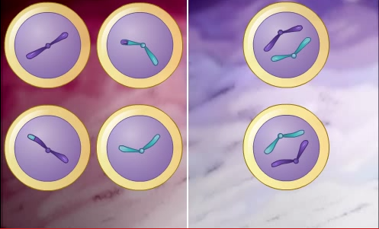
Cell Division https://www.youtube.com/watch?v=Ba9LXKH2ztU

Slide 13
Practice
Pg. 45 #1,3,4,10
Pg. 48 #1,2,3,7
Define the term DNA in your own Words and explain its function
What is a chromosome? Describe its function
What is an allele? Describe its function
If a Chromosome is compared to a book, what would the words in the book be compared to? Explain your answer
Describe a type of cell division that occurs during the asexual reproduction of a unicellular organism
What type of cell division is required for sexual reproduction? How does it differ from the cell division during asexual reproduction.
Describe the type of cell division that occurs in the body cells of multicellular organisms
If the amount of DNA in a gamete of an organism is n, is the amount of DNA in the body cells of that organism equal to ½n, n, or 2n? Explain

