Slide 1
Scientific Method
Introduction to Science

Slide 2
Design a Problem

Slide 3
Do Research

Slide 4
Variables

Slide 5
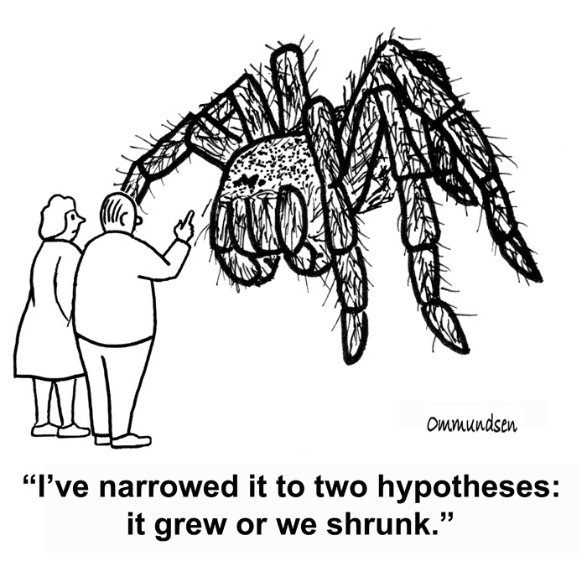
Hypothesis

Slide 6
Design an Experiment

Slide 7
Make Observations

Slide 8
Conclude

Slide 9
Experimental Error

Slide 10
Peer Review

