Slide 1
Transportation of Chemicals
Section 3.1

Slide 2
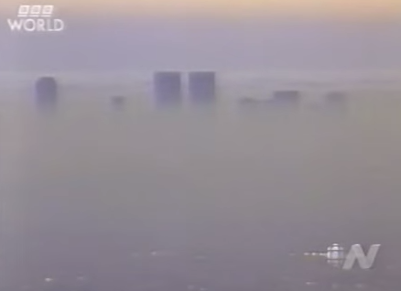
https://www.youtube.com/watch?v=4913yB5ozEE

Slide 3
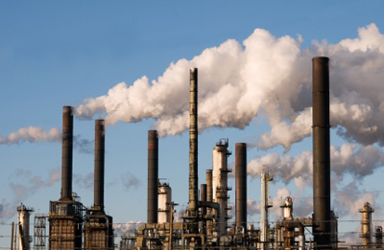
Transport in Air

Slide 4
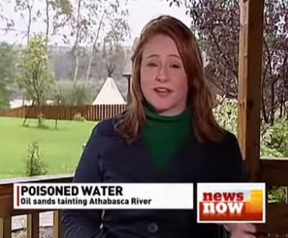
https://www.youtube.com/watch?v=OjxAGNsCNW0

Slide 5
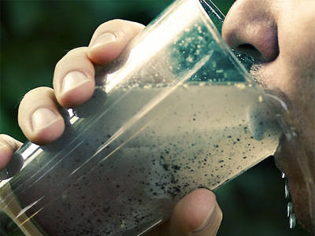
Transport in Water

Slide 6
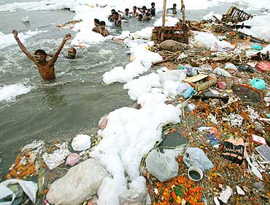
Surface Water

Slide 7
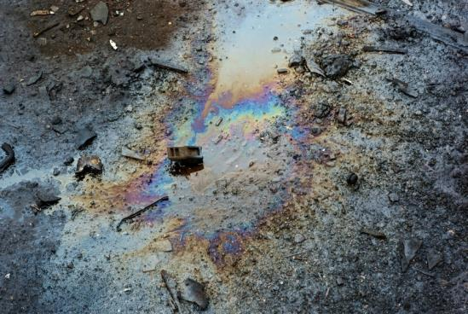
Transport in Soil

Slide 8
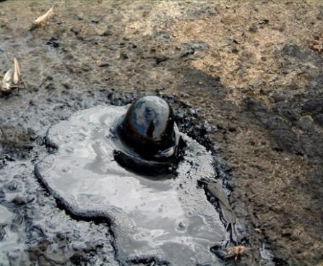
Transport of Hydrocarbons

Slide 9
Practice
Pg. 242
Questions 5-7

Slide 10
